Slide 1
An Introduction to Always Encrypted
Justin Dearing
Twitter: @zippy1981
zippy1981@gmail.com

Slide 2

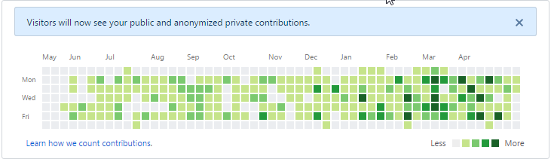


Facts about Justin Dearing
Been coding lately in:
C#
PowerShell
Terraform
TypeScript
T-SQL

Slide 3
What is Always Encrypted?
Encryption at rest and in transit for specific columns.
Introduced in SQL Server 2016 RTM Enterprise Edition.
Available in all SKUs as of 2016 SP1.

Slide 4
What isn’t Always Encrypted?
Encryption for the entire TDS stream.
Encryption between the browser and web server.

Slide 5
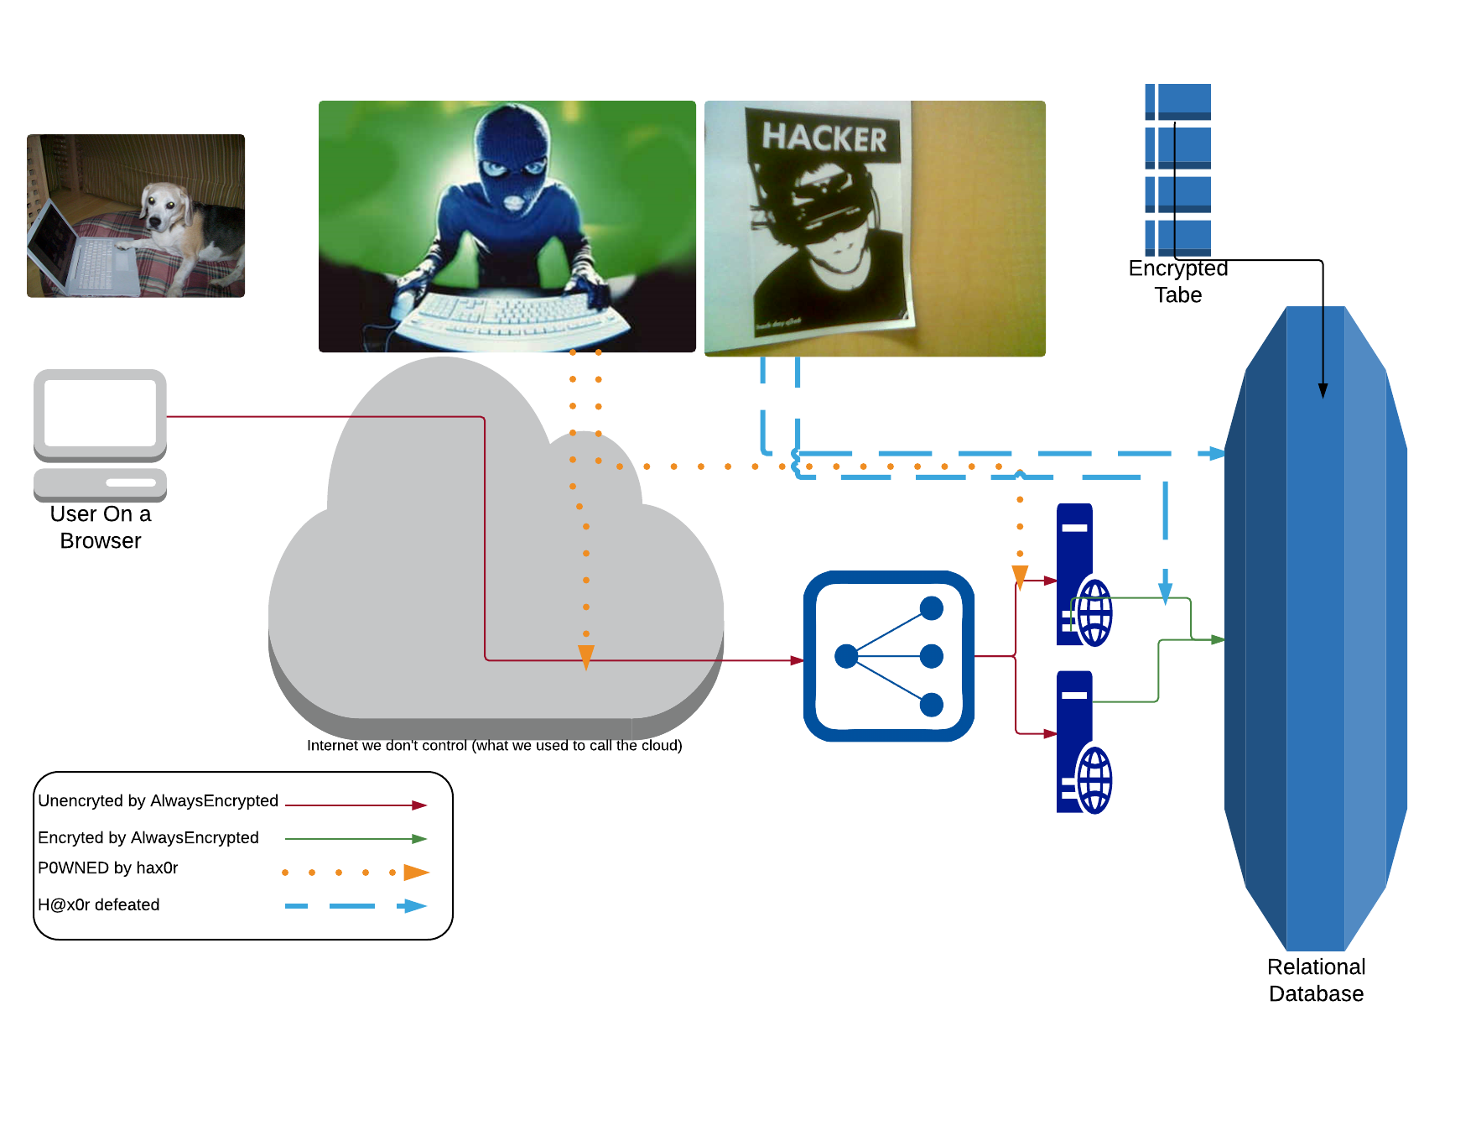

Always Encrypted Database
Content Switch

Slide 7
Conclusion
Always Encrypted is encrypted in more places than TDE, but not the whole chain.

Slide 8
What does Always Encrypted require?
Driver support in the application.
Self Signed Certificates to be generated.
A Column Master Key (CMK) meta data object in SQL Server
An encrypted key of the key generated.
The connection string key/value pair Column Encryption Setting=enabled

Slide 9
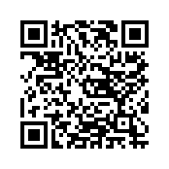
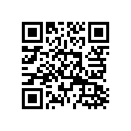
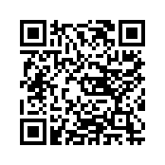
Drivers
ODBC (Windows and Linux) | System.Data.SqlClient | Java | FreeTDS | PHP
Microsoft ODBC Driver 13 | .NET Framework 4.6+(4.6.1+ for key rotation and bulk copy) .NET Core ODBC Driver or Microsoft.Data.SqlClient 1.0.19128.1 (Preview)+ | Microsoft JDBC Driver 6.0 https://www.microsoft.com/en-us/download/details.aspx?id=11774 | No response from the author on a feature request I made in 2016. | PHP 7.0+ PHP Sql Server Driver 5.2+
Notes:
Additional links:
SQL Client Downloads
Always Encrypted 6
System.Data.SqlClient
PHP Driver on Github https://github.com/microsoft/msphpsql

Slide 10

Did the speaker say self signed certificate???

Slide 11
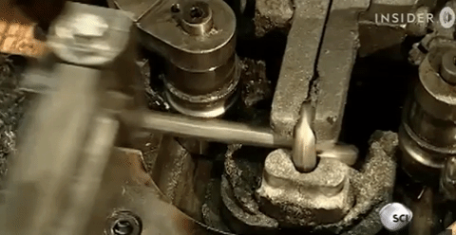
What about the chain of trust?

Slide 12
No Cert Verification Performed by the Drivers
The drivers do not verify the chain of trust.
The drivers do not even check the encryption expiration date.

Slide 13
Keys and Certs
Certificate with Private Key | Stored in the User or Computer Certificate Store Never on the SQL Server
Column Master Key | SQL Server Metadata object pointing to the URI of the certificate
Column Encryption Key | Encrypted Copy of One or Two Certificate private keys

Slide 14
Certificate generation
$MasterKeyDNSName = 'CN=Always Encrypted Sample Cert'
$Cert = New-SelfSignedCertificate `
-Subject $MasterKeyDNSName `
-CertStoreLocation Cert:\CurrentUser\My `
-KeyExportPolicy Exportable `
-Type DocumentEncryptionCert `
-KeyUsage DataEncipherment `
-KeySpec KeyExchange
NEW-ISH SYNTAX

Slide 15
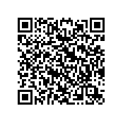
Old Syntax
$cert = New-SelfSignedCertificate `
-DnsName $MasterKeyDNSName `
-CertStoreLocation Cert:\CurrentUser\My `
-Provider 'Microsoft Strong Cryptographic Provider' `
-KeyUsage KeyEncipherment
-TextExtension @(
"2.5.29.37={text}1.3.6.1.5.5.8.2.2,1.3.6.1.4.1.311.10.3.11"
)
https://justdaveinfo.wordpress.com/2015/10/15/always-on-encrypted-generating-certificates-and-column-encryption-key-encrypted_value/

Slide 16
Removing Certs
# By Subject (non-unique descriptive name)
Get-ChildItem Cert:\CurrentUser\My | Where-Object subject -eq $MasterKeyDNSName | Remove-Item
# By thumbprint (unique identifier in the certificate store)
Remove-Item "Cert:\CurrentUser\My\$($Cert.ThumbPrint)"

Slide 17
Exporting Certs
# On the machine with the cert
$Password = [System.Web.Security.Membership]::GeneratePassword(24,5) | ConvertTo-SecureString -AsPlainText -Force
Export-PfxCertificate -CertStoreLocation Cert:\CurrentUser\My -FilePath "$($MasterKeySQLName).pfx" -Password $Password

Slide 18
Copying the cert over
# Transfer the PFX via whatever protocol or methodology makes sense.
# Also create a remote session to the destination machine

Slide 19
Importing Certs
# On the destination machine we run the import command.
Invoke-Command -ComputerName $Destination -ScriptBlock {
Import-PfxCertificate
-CertStoreLocation Cert:\CurrentUser\My
-FilePath "$($MasterKeySQLName).pfx"
-Password $Using:Password # $Using: resolves to local scope in a remote session
Remove-Item "$($MasterKeySQLName).pfx"
}
Remove-Item "$($MasterKeySQLName).pfx"
$Password.Clear() # We don’t need this anymore.

Slide 20
Importing Certs On Azure Web App
# az login is an exercise left to the reader
az webapp config ssl upload `
--resource-group AlwaysEncryptedSample `
--name "AlwaysEncryptedWeb" `
--certificate-file .\AlwaysEncryptedSampleCMK.pfx `
--certificate-password "$Password"

Slide 21
SQL Object Time
# Lets update our sql server module
Install-Module sqlserver -AllowClobber -Scope CurrentUser
Import-Module sqlserver
# If we are writing a script
#Requires -Modules sqlserver

Slide 22
Creating the CMK and CEK
$Database = Get-SqlDatabase -ConnectionString $ConnectionString
$cmkSettings = New-SqlCertificateStoreColumnMasterKeySettings
$Database | New-SqlColumnMasterKey `
-Name $MasterKeySQLName `
-ColumnMasterKeySettings $cmkSettings
-CertificateStoreLocation "CurrentUser"
-Thumbprint $Cert.Thumbprint
$Database | New-SqlColumnEncryptionKey -ColumnMasterKey $MasterKeySQLName -Name 'Logging'

Slide 23
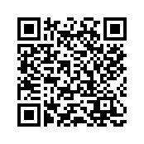
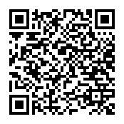
Creating the CMK and CEK deep dive
Copy-Pasta PowerShell from here
Color Commentary
Notes:
Copy-Pasta here: https://msdn.microsoft.com/en-us/library/mt732057.aspx
Color commentary https://blogs.technet.microsoft.com/dataplatforminsider/2016/06/30/sql-powershell-july-2016-update/

Slide 24
Encrypting Columns
$LogSchema = 'Logging'; $encryptionChanges = @()
$encryptionChanges += New-SqlColumnEncryptionSettings `
-ColumnName "$($LogSchema).Log.User" `
-EncryptionType Deterministic `
-EncryptionKey $LogColumnKeyName
$encryptionChanges += New-SqlColumnEncryptionSettings `
-ColumnName "$($LogSchema).Log.ClientIP" `
-EncryptionType Deterministic `
-EncryptionKey $LogColumnKeyName
$Database | Set-SqlColumnEncryption `
-ColumnEncryptionSettings $encryptionChanges

Slide 25
Examining CMKs and CEKs with System Views
SELECT * FROM sys.column_master_keys;
SELECT k.*, encrypted_value, encryption_algorithm_name
FROM
sys.column_encryption_keys k
INNER JOIN sys.column_encryption_key_values kv
ON k.column_encryption_key_id=kv.column_encryption_key_id;

Slide 26
Key rotation and Azure Key Vault

Slide 27

Porting considerations
Entity Framework: you should be golden.
Parameterized queries: also golden
String concatenation: BAD
Encrypting Columns used as query filters (WHERE, HAVING, ON etc), potentially problemsome.

Slide 28
Paramaterize Queries .NET
cmd.CommandText = "UPDATE [Authentication].[AspNetUsers] SET [SSN] = @SSN WHERE Id = @Id;";
cmd.Parameters.Add("@SSN",SqlDbType.VarChar, 11);
cmd.Parameters["@SSN"].Value = ssn;
cmd.Parameters.AddWithValue("@Id", User.Identity.GetUserId());
cmd.ExecuteNonQuery();
Notes:
Its important to add param

Slide 29
Porting caveats
Less forgiveness about casting between VARCHAR and NVARCHAR
DETERMINISTIC vs RANDOM encryption
RANDOM more secure
DETERMINISTIC sortable and indexable
Must use binary collation.

Slide 30
What is collation?
collate ‎(third-person singular simple present collates, present participle collating, simple past and past participle collated)
(transitive) To examine diverse documents et cetera to discover similarities and differences.
(transitive) To assemble something in a logical sequence.
(transitive) To sort multiple copies of printed documents into sequences of individual page order, one sequence for each copy, especially before binding.
https://en.wiktionary.org/wiki/collate

Slide 31
SQL Server Collation: The Short Version
You’re default collation is probably Latin_General_CI_AI:
CI = Case Insensitive, AI = Accent Mark Insensitive
Lopez == LOPEZ == Lòpez
You’re encrypted columns are going to have to be changed to Latin_General_BIN
Sorting is based on the unicode character numbers of the letters.
Lopez <> LOPEZ <> Lòpez

Slide 32
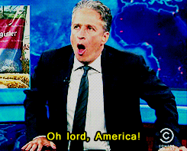
Binary collation for Americans (8 bit)
Characters sorted by ASCII Value
K (0x4B) comes before j(0x6A)
Foreign accent marks come after stuff on the ASCII table

Slide 33

Binary collation for NATO ALLIES (16 bit)
N((VAR)?CHAR|TEXT) columns i.e UTF-16
ASCII
European Accent Marks, Arabic, Hebrew
Indic, Thai, certain symbols (e.g euro), Chinese, Japanese, Korean
Private Use Area #1 (Emoticons??)
Notes:
5 minutes of research into where emoticons were taught me it would take several hours of research to refine my knowledge of Unicode. Emoticons are stored in blocks 1F600–1F64.

Slide 34
Collation Trivia Time!
What US county name can’t be encoded in the original 128 character ASCII table?

Slide 35
Answer
Doña Ana, New Mexico
Notes:
I discovered this because I was parsing the US Census county level FIPS data in python in a way that assumed text was limited to the first 128 characters of the ASCII table.

Slide 36
Collation conclusions
You don’t gain or lose anything encoding wise with binary collation
Your do lose case and accent mark insensitivity
Why are you sorting on this data? (Maybe medical stuff??)

Slide 37
Migrating Existing Data
You need to create/replace tables
The Set-SqlColumnEncryption cmdlet hides this fact

Slide 38
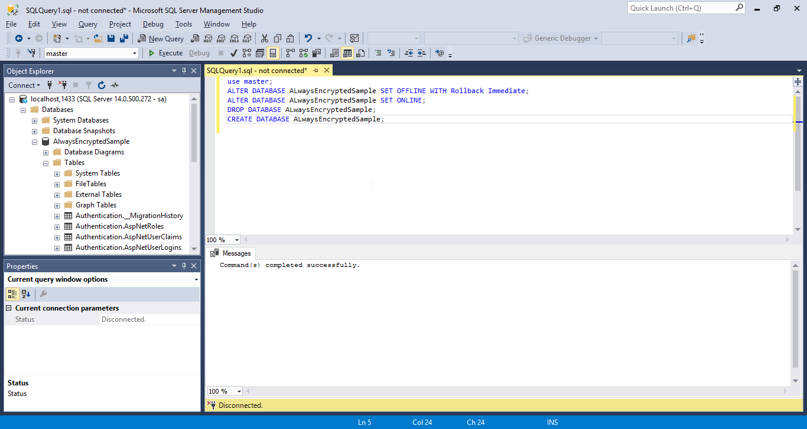
SSMS, sqlcmd and Azure Data Studio

Slide 39
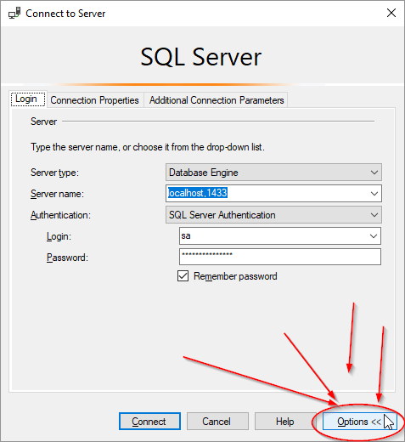
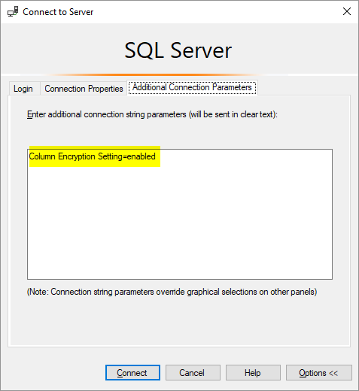
SSMS Setup

Slide 40
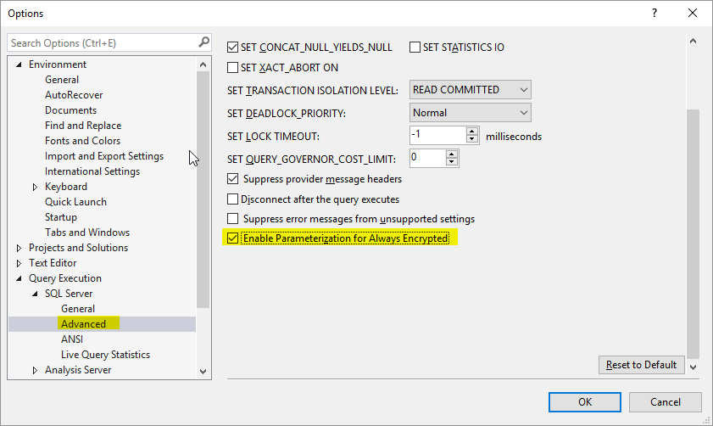
SSMS Setup

Slide 41
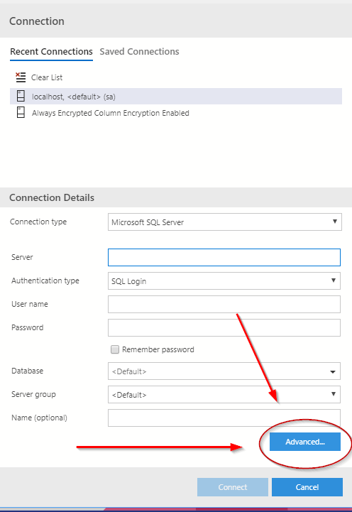
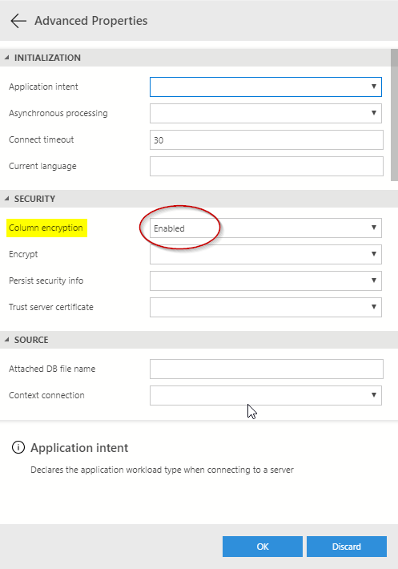
Azure Data Studio

Slide 42
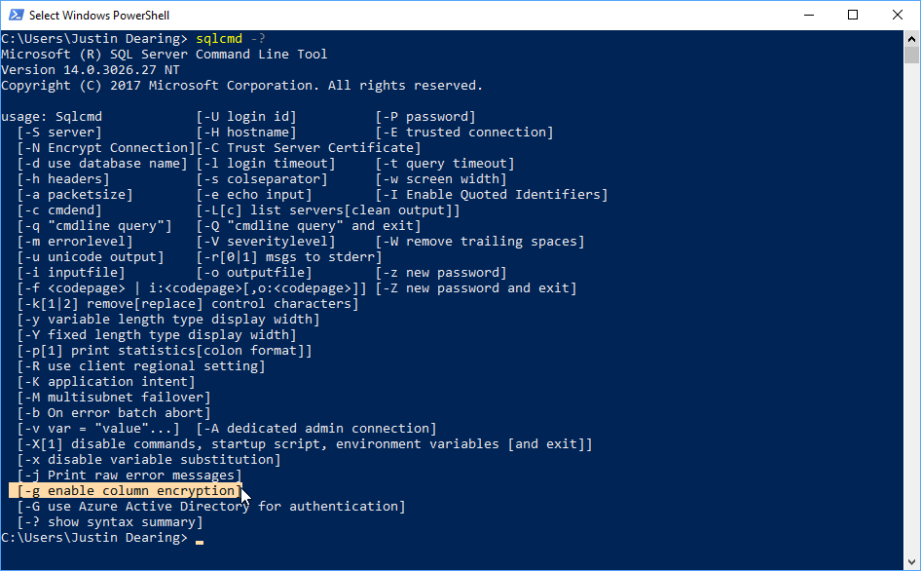
SQLCMD.EXE
-g (lowercase g)

Slide 43
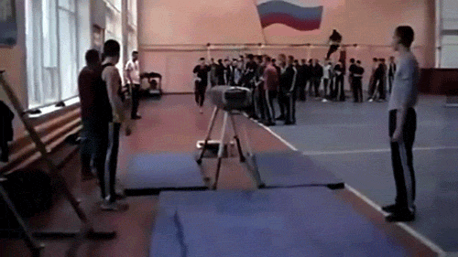
PowerShell Notebook Demo

Slide 44
Thanks for coming
zippy1981@gmail.com or @zippy1981 on twitter if you have questions or feedback.
Fill out your evaluation forms.
Code Sample https://github.com/sqlcollaborative/AlwaysEncryptedSample

